Slide 1
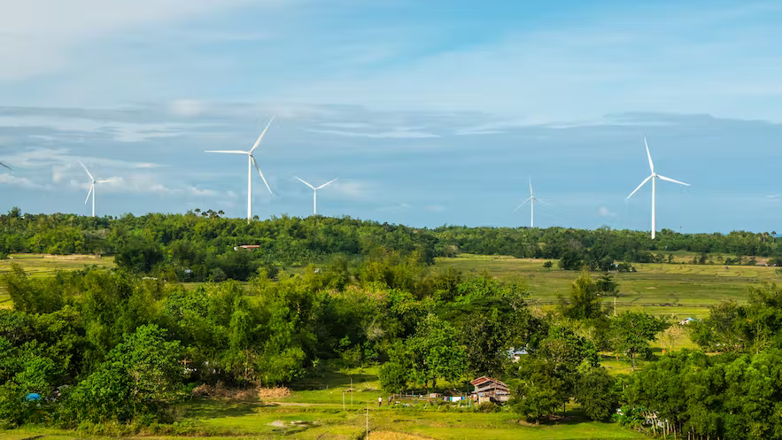

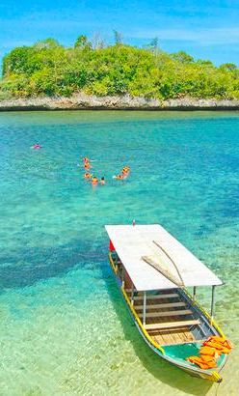
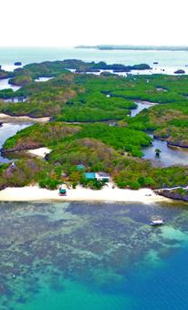

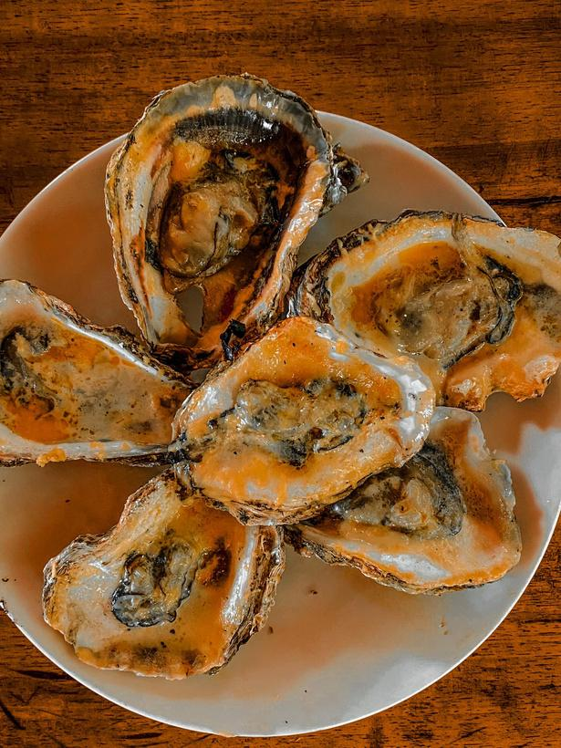
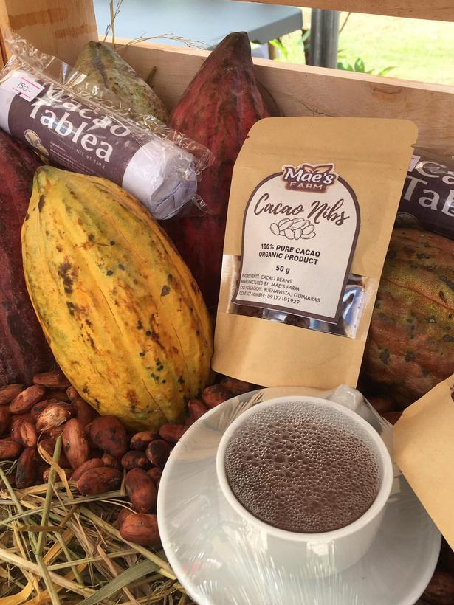
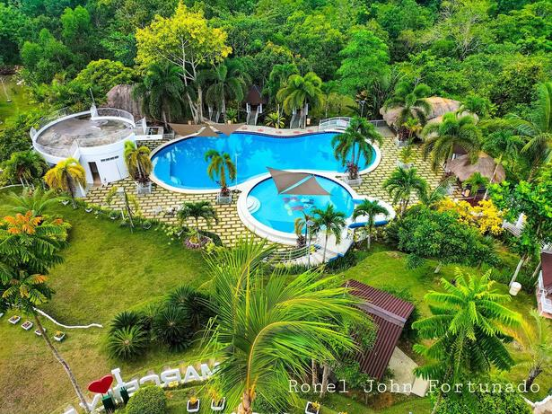
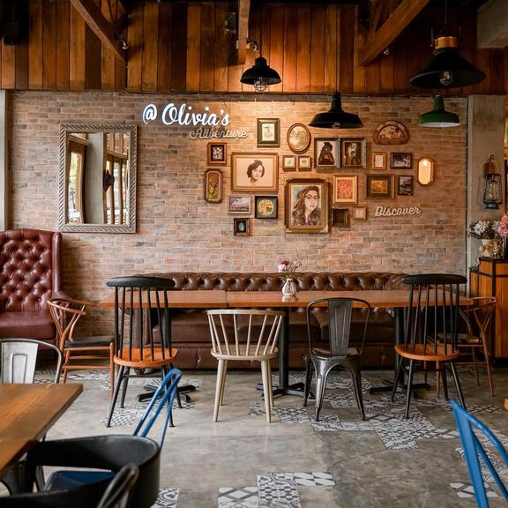


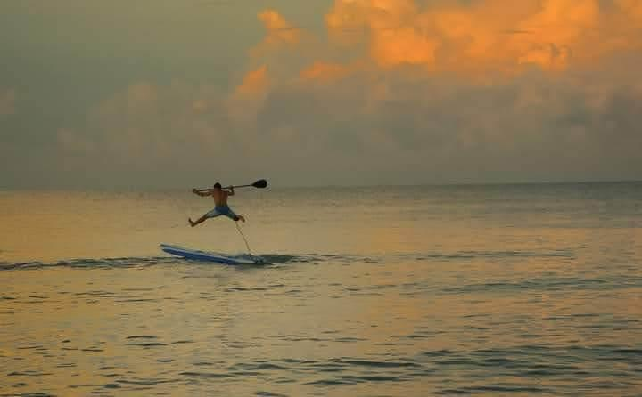
GUIMARAS
MANGOES AND MORE

Slide 2
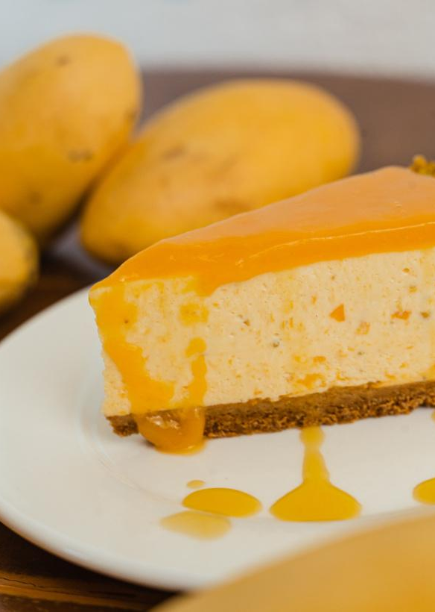
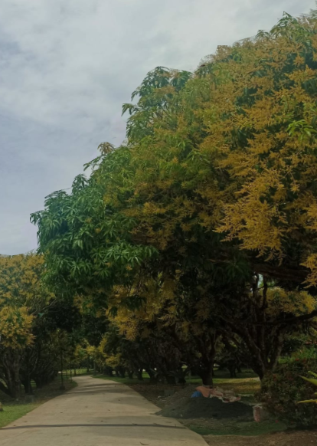
what's new in guimaras?
fun.
food.
festivals.
farms.
GUIMARAS
MANGOES AND MORE

Slide 3
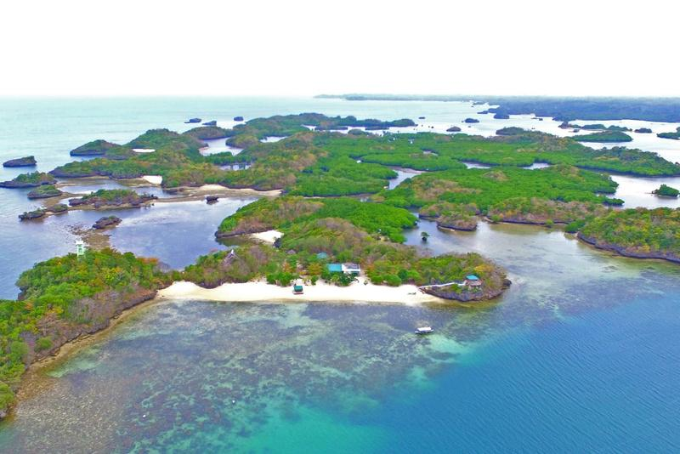
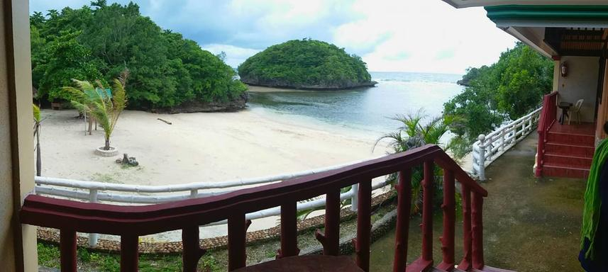
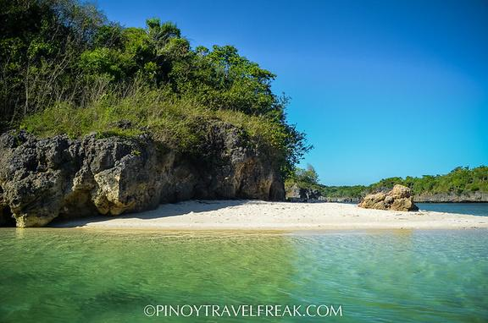
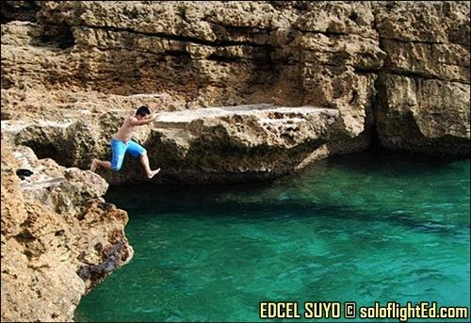
MANGOES AND MORE
Marine reserve and islets to explore
Taklong Island National Marine Reserve
La Puerta Al Paraizo Beach Resort
Lapaz - San Roque, Nueva Valencia, Guimaras
San Roque, Nueva Valencia, Guimaras
Ave Maria Islet
Villa Igang Beach Resort
Lawi, Jordan, Guimaras
Poblacion, Nueva Valencia, Guimaras

Slide 4
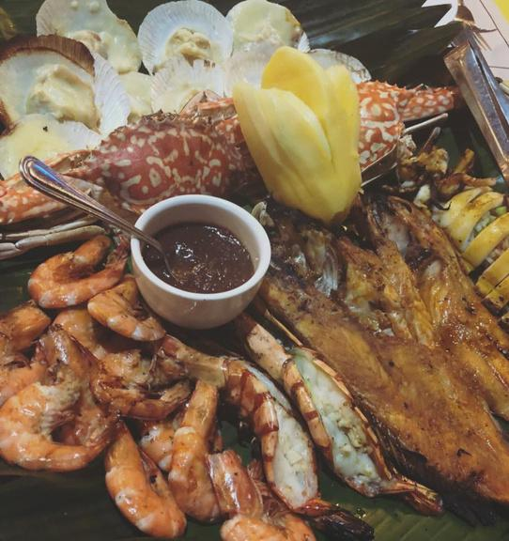
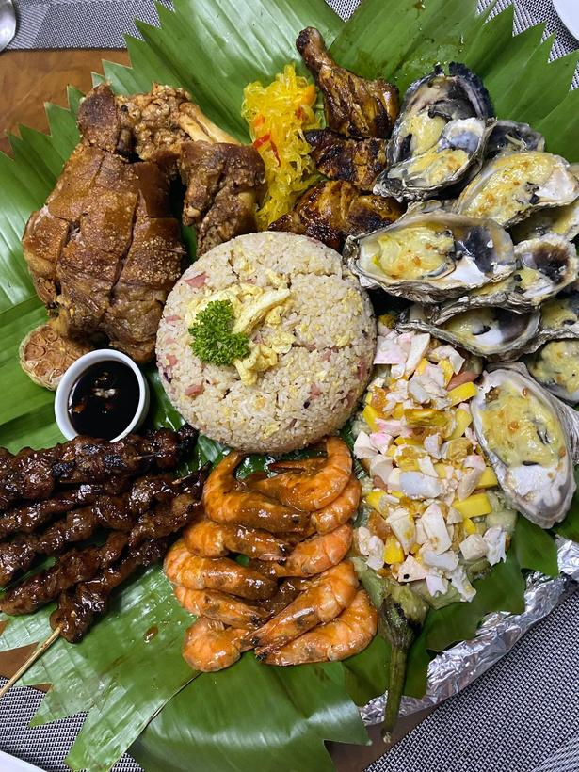
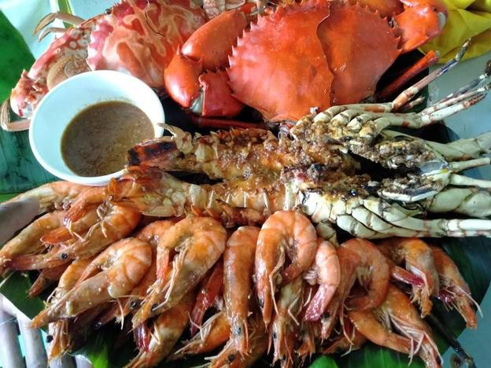
MANGOES AND MORE
seafoods to taste.
Biking's Seafoods Resto
Guimaras Mountain Resort
San Miguel, Jordan, Guimaras
Piña-Daragan, Buenavista, Guimaras
Makarios Aquafarm and Restaurant
Charle's Floating Restaurant
Tando, Nueva Valencia, Guimaras
Poblacion, Nueva Valencia, Guimaras

Slide 5
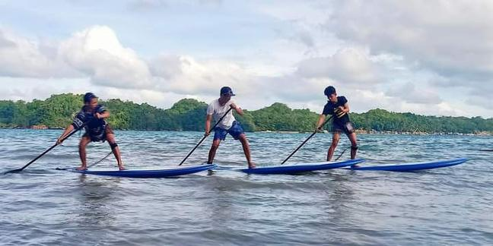
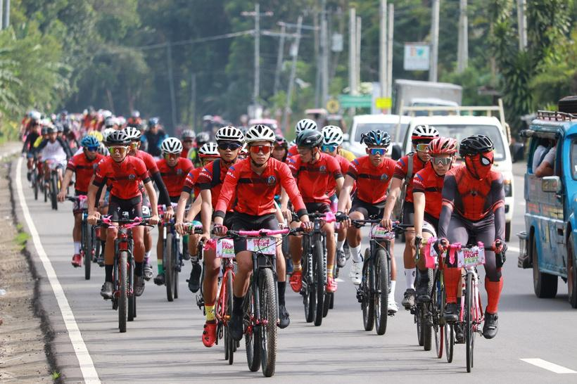
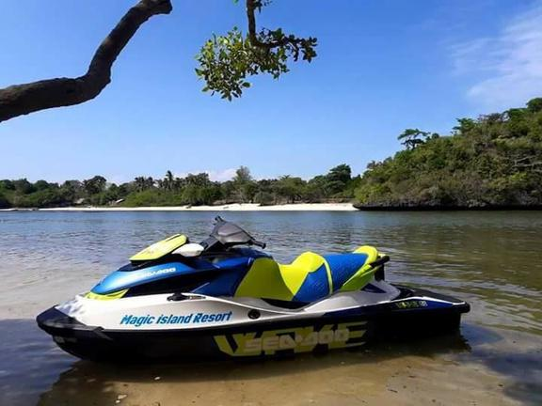
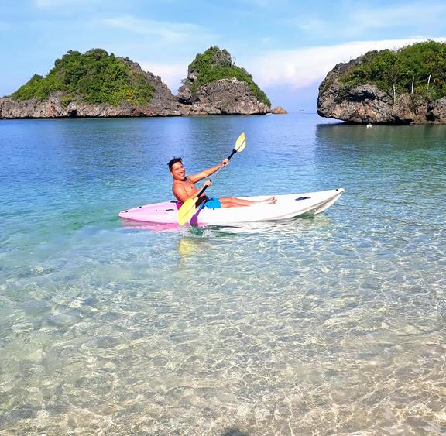
MANGOES AND MORE
adventure Activities to enjoy
Paddling Sessions
Biking
Beaches of Nueva Valencia, Guimaras
Circumferential Rd. and Hillsides of Guimaras
Jet Ski
Kayaking
Magic Island Resort, Nueva Valencia, Guimaras
Tatlong Pulo, Jordan, Guimaras

Slide 6
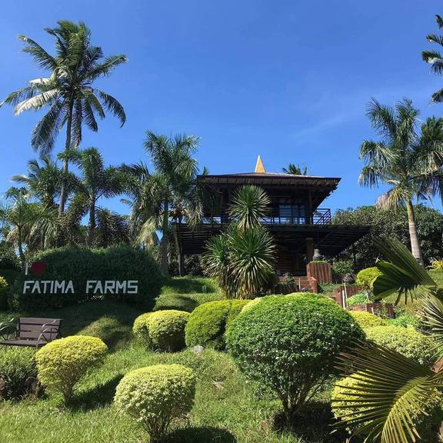
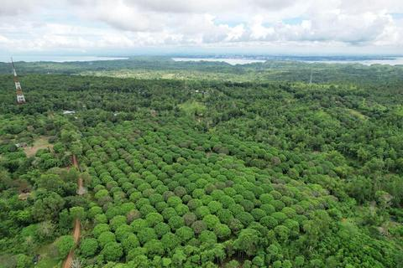

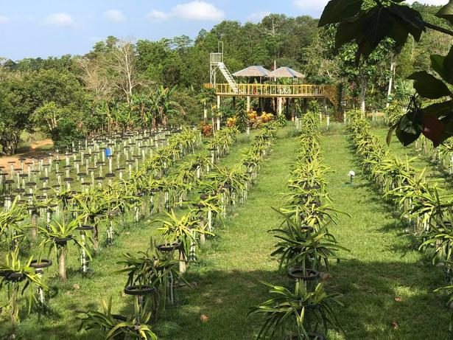
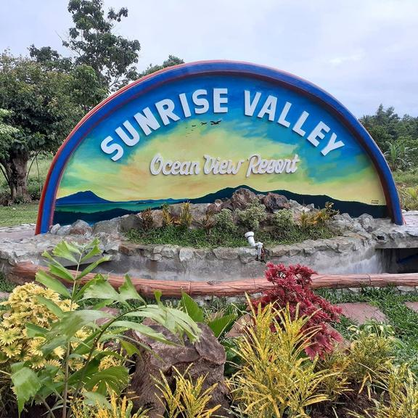
MANGOES AND MORE
farms and sites to discover
Fatima Farm Resort
Wonder's Farm
Jem Home Farm
San Nicolas, San Lorenzo, Guimaras
Tamborong, San Lorenzo, Guimaras
Millan, Sibunag, Guimaras
Dom's Dragon Fruit Farm
Mae's Farm
Sunrise Valley Oceanview Resort
Oracon Sur, Nueva Valencia, Guimaras
San isidro, Buenavista, Guimaras
Cabano, San Lorenzo, Guimaras

Slide 7
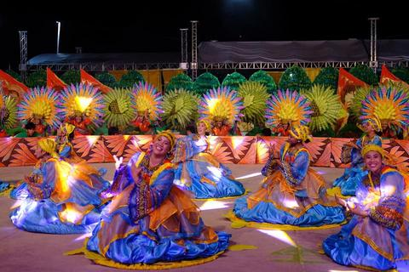
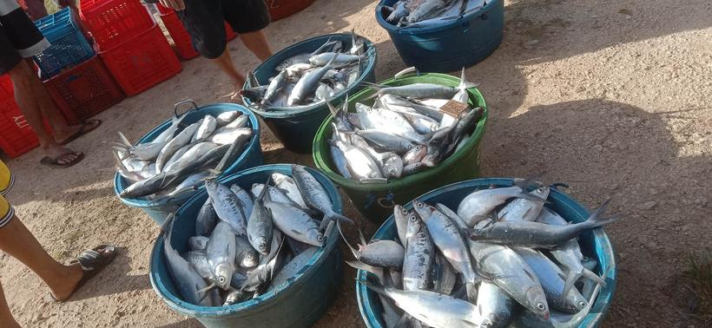

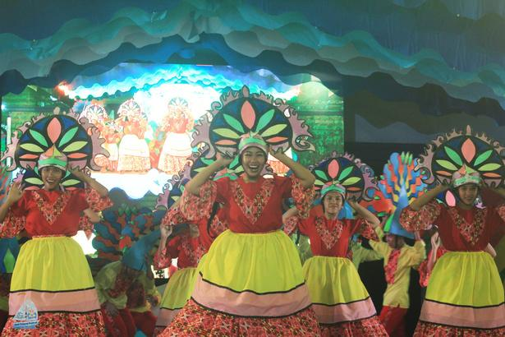
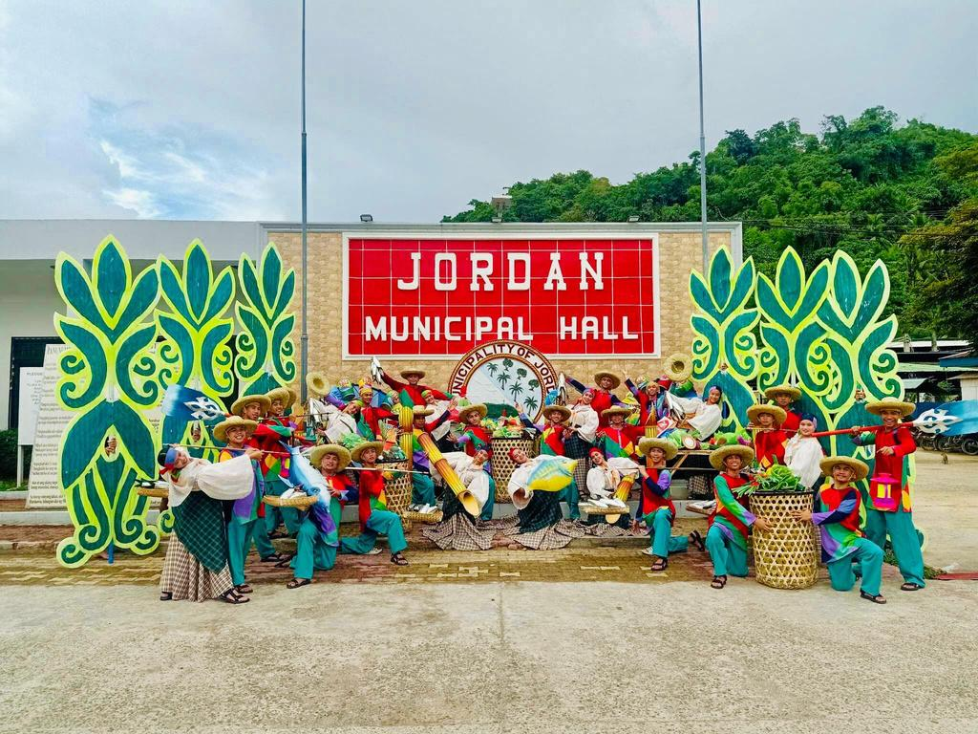
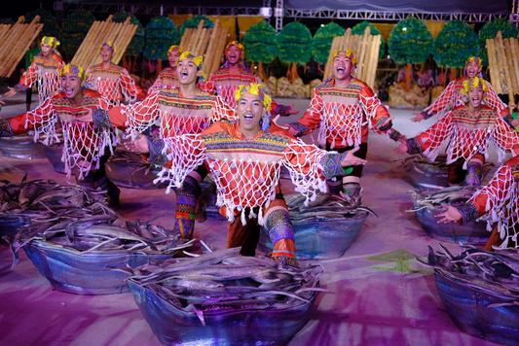
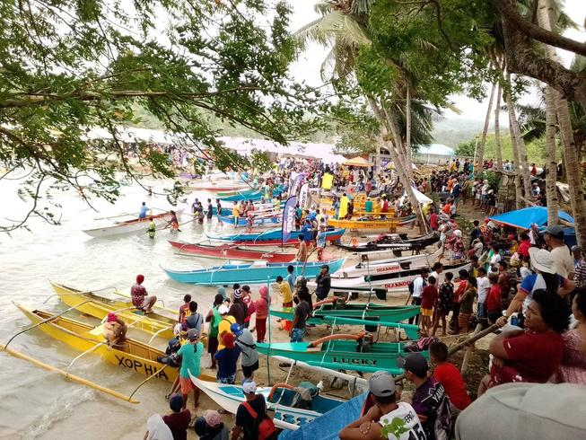
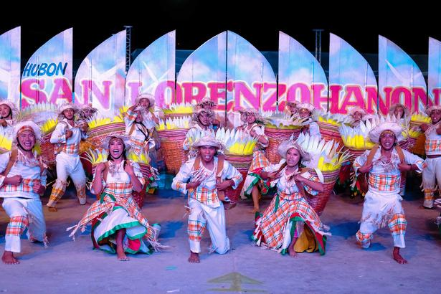
MANGOES AND MORE
Festivals to experience
Manggahan Festival
Dragon Fruit Festival
Bangus Festival
Lenten Season
Province of Guimaras
Province of Guimaras
Province of Guimaras
Municipality of Jordan, Buenavista and San Lorenzo
MUNICIPAL FESTIVALS
Palayag Festival
Bulantihan Festival
Balsahan Festival
Sadsaran Festival
Pag-Ani Festival
Buenavista, Guimaras
Jordan, Guimaras
Sibunag, Guimaras
Nueva Valencia, Guimaras
San Lorenzo, Guimaras

Slide 8
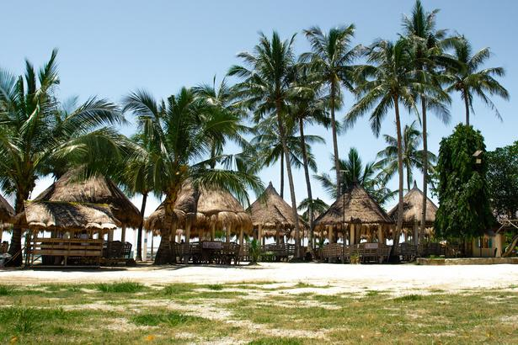
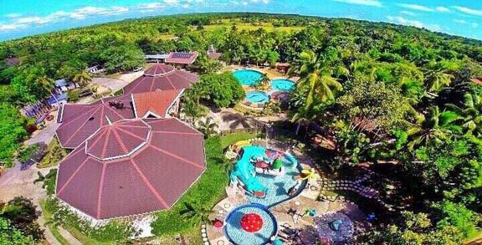
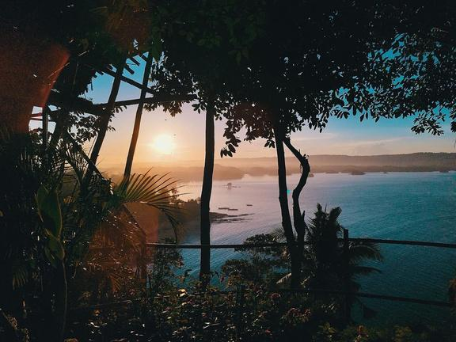
MANGOES AND MORE
accredited resorts
Alobijod Cove Resort
Guimaras Mountain Resort
Lapuerta El Paraizo Beach Resort
Poblacion, Nueva Valencia, Guimaras
Piña-Daragan, Buenavista, Guimaras
San Roque, Nueva Valencia, Guimaras
Marceily Point Resort
Nature's Eye Beach Resort
Piña, Buenavista, Guimaras
Tando, Nueva Valencia, Guimaras

Slide 9
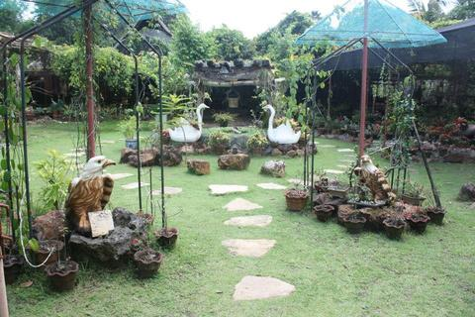
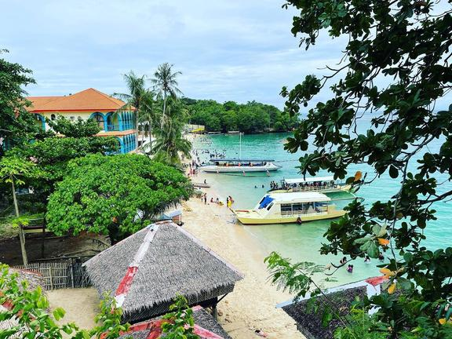
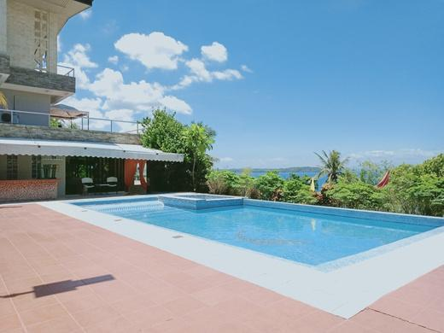
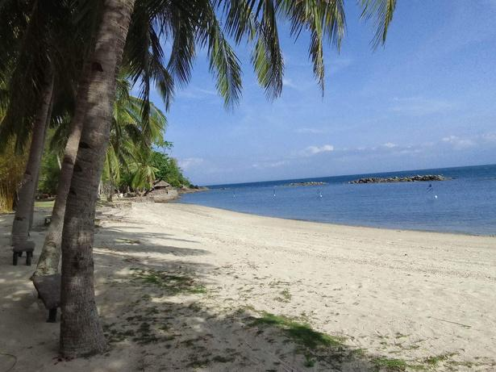
MANGOES AND MORE
accredited resorts
Neptune Pittman's Garden
Raymen Beach Resort Corp.
Sunsea Resort Guimaras
Tastasan, Buenavista, Guimaras
Poblacion, Nueva Valencia, Guimaras
Canhawan, Nueva Valencia, Guimaras
Vilches Beach Resort
Costa Aguada Island Resort
San Enrique, San Lorenzo, Guimaras
Inampulugan, Sibunag, Guimaras

Slide 10
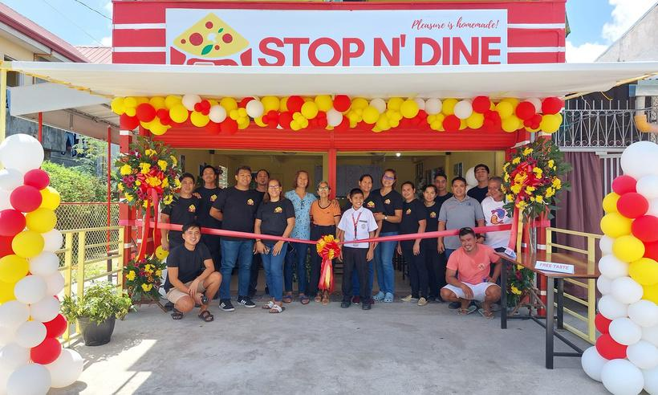
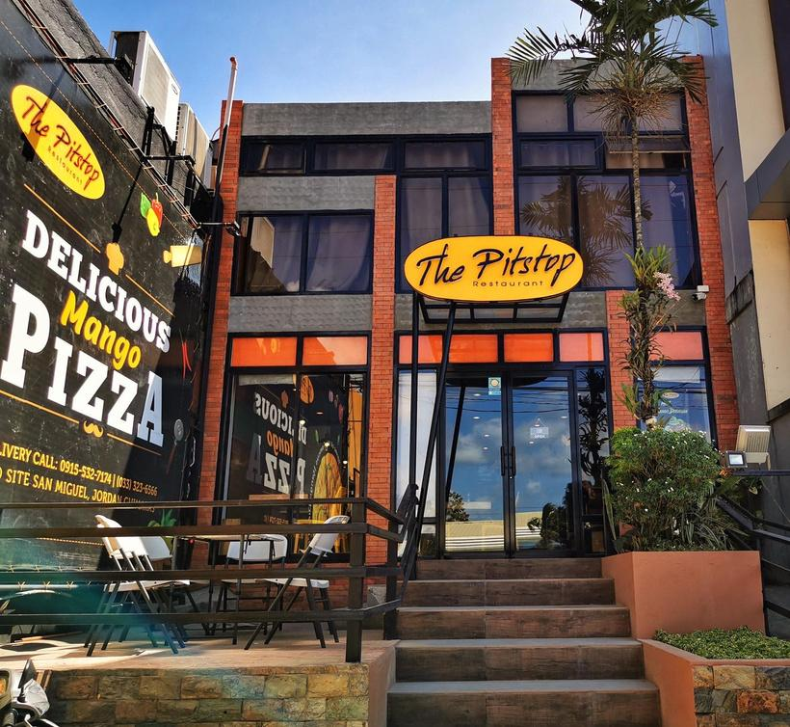
MANGOES AND MORE
ACCREDITED restaurants
Stop N' Dine Pizza Hauz
The Pitstop
Olivia's Kitchen and Island Brew
Mclain, Buenavista, Guimaras
San Miguel, Jordan, Guimaras
San Miguel, Jordan, Guimaras

Slide 11
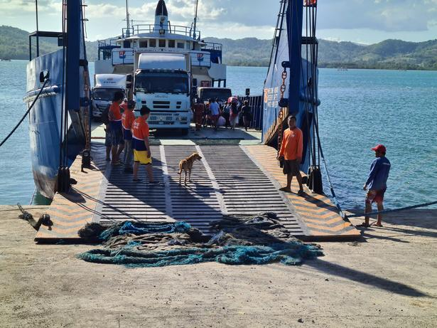
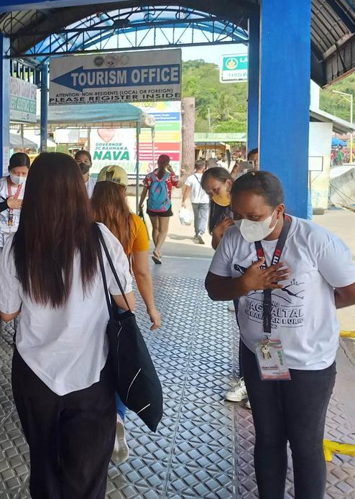
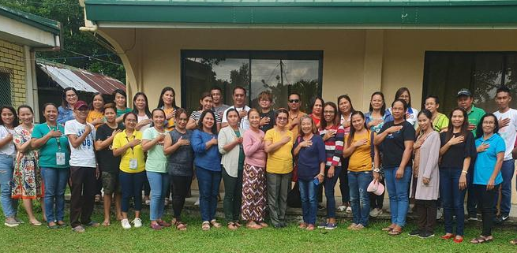

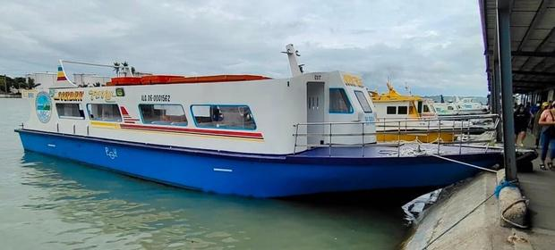
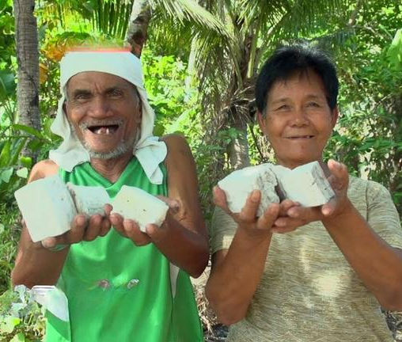
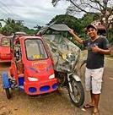
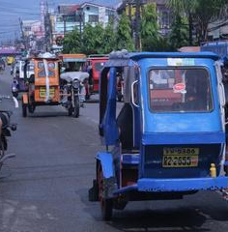

MANGOES AND MORE
Local Government initiatives to enhance
tourist experience
Connected travels.
Courteous frontliners.
Friendly Communities.
Forward looking plans.

Slide 12
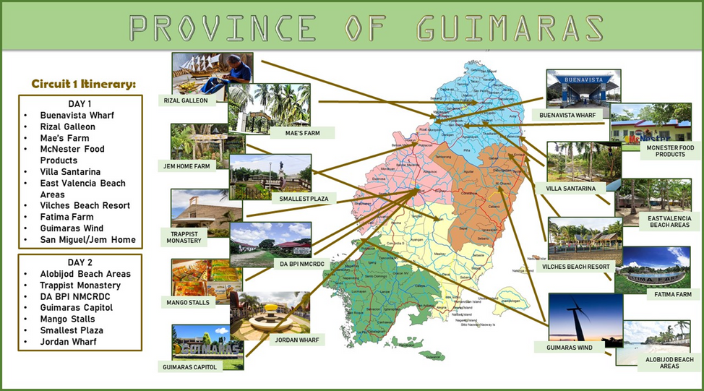
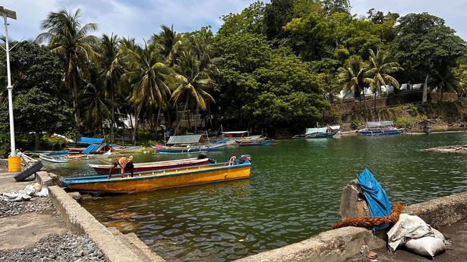



MANGOES AND MORE
Local Government initiatives to enhance tourist experience
Sta. Ana Bay Waterfront Sustainable Development Project
Nueva Valencia, Guimaras
Tourism Information Centers
Province of Guimaras
Guimaras Provincial Forest Tree Park Development
Province of Guimaras
Better tourism circuits.
New projects.

Slide 13




GUIMARAS
MANGOES AND MORE
Connect with us.
Email
pedoffice.guimaras@gmail.com
Social Media
Guimaras Mangoes and More
Provincial Economic Development Office
Guimaras Tourism
Contact Person
Mr. Francis Gentoral, EnP
PED Officer

